Slide 1


BILKENT UNIVERSITY EEE 493 – INDUSTRIAL DESIGN PROJECT
Abdülkerim Aydın
Oğuzhan Demir
Cüneyt Yıldız
Burak Cevat Civek
Ceren Uyanık
Burak Kakillioğlu
Presentation I
19.09.2014

Slide 2
Outline
Introduction
Project Description
Project Progress
Usage of the End-Product

Slide 3
Introduction
Project Name
Monitoring Tilt and Temperature Data For
Structural Health Monitoring
Company
KAREL R&D
Academic Mentor
Dr. Nail AKAR
Company Mentor
Dr. Alper SARIKAN
E-mail : alper.sarikan@karel.com.tr
Phone : 0 312 265 02 90

Slide 4
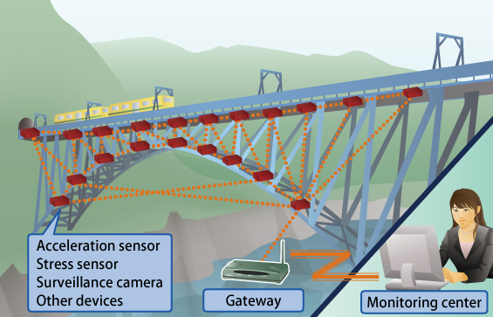
Project Description
Structural Health Monitoring
Controlling Tilt and Temperature Data

Slide 5
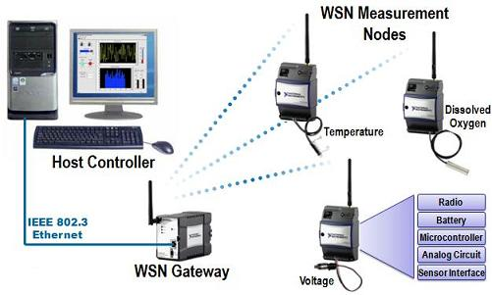
Project Description
Wireless Sensor Network
Autonomous sensors
One Sensor – One Node
Gateway Sensor Node (Main Machine)

Slide 6
Project Progress
Previous progress
Preliminary research about the project
Meeting with company mentor
Current progress
Reading articles
Project plan
Division of labor
System Designer, Software Designer, Electronic Designer

Slide 7
Project Progress
Future Progress
Protocol Development
Header, Protection, Unique ID, Route etc.
Software Simulation
C++, QT Modeling Software
Analysis of the Simulations
Drawbacks of the protocol, corrections, route analysis
Hardware Design
Embedding developed protocol in boards
Measuring the target real life data

Slide 8
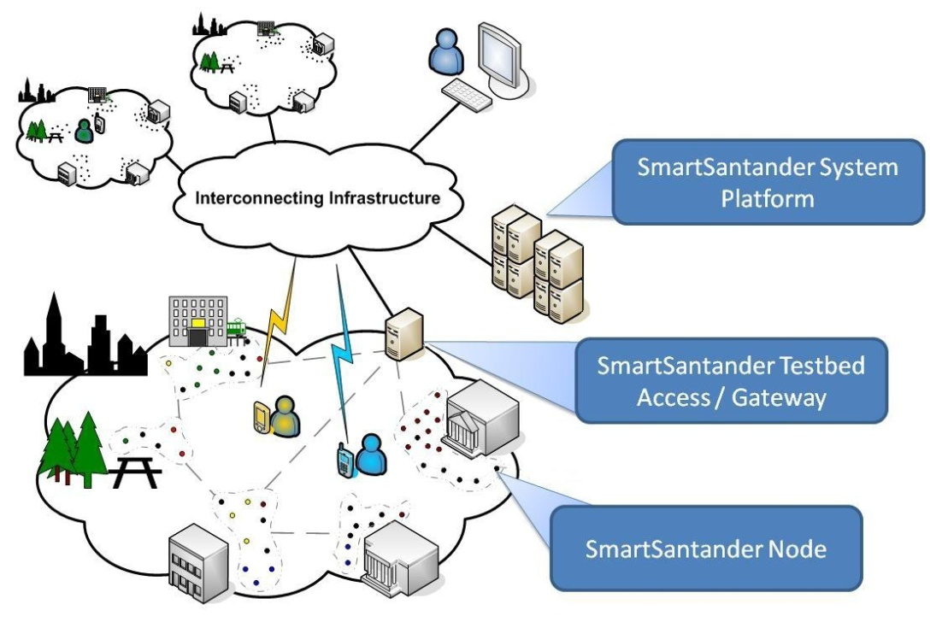
Usage of the End-Product
Developing technology
Smart Cities/Houses
Infrastructural applications
Bridge, Highway, Mines etc.
Healthcare Monitoring

Slide 9
Thank you for listening!

